Slide 1


Slide 2
The Punchline
Great news! A November 2024 bond measure is viable for your district.
Viability is consistently in the high 60 percentiles wire to wire in the survey for a 55% requirement bond.
CFS encourages the District to build on these results by continuing to seek stakeholder, civic leader and community input and to prepare for potential bond placement this summer.
While a unanimous vote of the Board to place the measure for the voters to decide is ideal, the law requires a 4/5’s Board vote.

Slide 3




Survey Methodology
Dates | May 15-June 2, 2024
Research Population | Likely November 2024 Voters in Spreckels USD
Total Interviews | 241
Margin of Sampling Error | (Full Sample) ±6.3% at the 95% Confidence Level (Half Sample) ±9.0% at the 95% Confidence Level
Contact Methods
Data Collection Modes
Languages | English & Spanish
Telephone
Calls
Email
Invitations
Text
Invitations
Telephone
Interviews
Online
Interviews
(Note: Not All Results Will Sum to 100% Due to Rounding)

Slide 4
Your Community’s Attitudes

Slide 5
Two-thirds of voters have a favorable opinion of the District with local firefighters, nurses, farmers, and small business owners among the most favored groups.
(Ranked by Total Favorable)
Total Fav. | Total Unfav.
90% | 1%
84% | 6%
82% | 7%
81% | 6%
77% | 15%
76% | 13%
72% | 10%
68% | 20%
56% | 20%
55% | 8%
37% | 21%
^The Spreckels Union School District
Board of Education
I'm going to read a list of organizations and groups in your community. I would like you to tell me if you have a generally favorable or generally unfavorable opinion of each one. ^Not Part of Split Sample

Slide 6
Six-in-ten voters recognize the District’s need for additional funding.
Generally speaking, would you say that the Spreckels Union School District has a great need for additional funding, some need, a little need or no real need for additional funding?
Great/
Some Need
63%
Little/
No Real Need
19%

Slide 7
Initial Community Attitudes on Potential Bond Measure

Slide 8
Hypothetical Ballot Language Tested
(Reviewed by Legal Counsel)
Spreckels Union School District Classroom Repair, Upgrade, Safety Measure To repair/upgrade neighborhood schools, outdated electrical/ sewer systems, leaky roofs, plumbing; remove asbestos, lead paint, mold; provide safe drinking water; upgrade school security, fire safety, emergency communication systems; shall Spreckels Union School District’s measure authorizing $27,000,000 in bonds at legal rates, be adopted, levying $30 per $100,000/3¢ per $100 of assessed valuation, averaging $5,500,000 annually while bonds are outstanding, requiring oversight, audits, public disclosure of all spending, all funds for local schools?
Q. If the election were held today, would you vote yes in favor of this measure or no to oppose it? Split Sample

Slide 9
A majority of voters back a bond with a tax rate detailed in either dollars or cents, with the description using cents being the easiest to understand.
$30/$100,000
3¢/$100
Definitely yes
Probably yes
Undecided, lean yes
Undecided, lean no
Probably no
Definitely no
Undecided
Total Yes
58%
Total Yes
68%
53%
63%
Total No
32%
Total No
27%
If the election were held today, would you vote yes in favor of this measure or no to oppose it?

Slide 10
The measure carries across all age groups.
Initial Vote by Age
(% of Sample)
(27%)
(42%)
(31%)
If the election were held today, would you vote yes in favor of this measure or no to oppose it?

Slide 11
Support is consistent between men and women.
Initial Vote by Gender
(% of Sample)
(49%)
(51%)
If the election were held today, would you vote yes in favor of this measure or no to oppose it?

Slide 12
The measure has nearly equal support among white voters and all voters of color.
Initial Vote by Race/Ethnicity
(% of Sample)
(56%)
(36%)
If the election were held today, would you vote yes in favor of this measure or no to oppose it?

Slide 13
While 2/3’s of voters who are parents support the measure, support is highest among voters with no children.
Initial Vote by Children
(% of Sample)
(18%)
(31%)
(56%)
(19%)
If the election were held today, would you vote yes in favor of this measure or no to oppose it?

Slide 14
Education Priorities

Slide 15
The top priorities for funding and outcomes from the measure include fiscal accountability, repairing leaky roofs, retaining and attracting quality teachers, providing safe drinking water and providing a well-rounded education including arts and music.
(Ranked by Extremely/Very Important)
Ext./Very Impt.
85%
84%
83%
82%
82%
80%
77%
74%
74%
74%
74%
Providing a well-rounded education that includes arts and music
Ensuring all students learn in a classroom that is clean and safe
Thinking more about the potential Spreckels Union School District ballot measure you just considered, I am going to read you a list of individual features and provisions that might be included in the measure. Please tell me how important it is to you that each feature or provision be included in the measure. ^Not Part of Split Sample

Slide 16
Continued
(Ranked by Extremely/Very Important)
Ext./Very Impt.
73%
72%
72%
71%
71%
71%
70%
70%
69%
69%
67%
Thinking more about the potential Spreckels Union School District ballot measure you just considered, I am going to read you a list of individual features and provisions that might be included in the measure. Please tell me how important it is to you that each feature or provision be included in the measure. ^Not Part of Split Sample

Slide 17
Continued
(Ranked by Extremely/Very Important)
Ext./Very Impt.
66%
66%
66%
66%
66%
66%
64%
64%
64%
Thinking more about the potential Spreckels Union School District ballot measure you just considered, I am going to read you a list of individual features and provisions that might be included in the measure. Please tell me how important it is to you that each feature or provision be included in the measure.
Split Sample

Slide 18
Continued
(Ranked by Extremely/Very Important)
Ext./Very Impt.
62%
61%
61%
61%
60%
60%
60%
60%
60%
Thinking more about the potential Spreckels Union School District ballot measure you just considered, I am going to read you a list of individual features and provisions that might be included in the measure. Please tell me how important it is to you that each feature or provision be included in the measure.
Split Sample

Slide 19
Sources of Information

Slide 20
Mailers and local community newspapers are the most often used sources of information.
(Ranked by Frequently/Occasionally)
Freq./Occas.
70%
54%
44%
44%
35%
31%
29%
29%
27%
26%
22%
I am now going to read you a list of sources from which people get information about programs, events and issues in your area. I’d like you to tell me how often you use it to get information about such issues: frequently, occasionally, rarely, or never. ^Not Part of Split Sample

Slide 21
Conclusions

Slide 22
Conclusions
School Bond:
  A $27,000,000 school bond measure with a tax rate defined in cents, is viable for placement at the District’s August 1st meeting with two-thirds of voters currently supporting the measure.
  While this is very positive, CFS recommends continued engagement as your community appreciates outreach.
General Perceptions:
  A majority of voters have a favorable opinion of the District.
  Sixty-three percent of voters perceive the District has a need for additional funds.

Slide 23
Conclusions; Continued
Many of the potential impacts and outcomes tested in the survey are considered important by overwhelming numbers of voters.
The most important themes for voters include:
  Fiscal accountability/public disclosure
  Basic repairs including repairing leaky roofs
  Retaining and attracting quality teachers
  Providing safe drinking water
  Providing a well-rounded education including arts and music

Slide 24
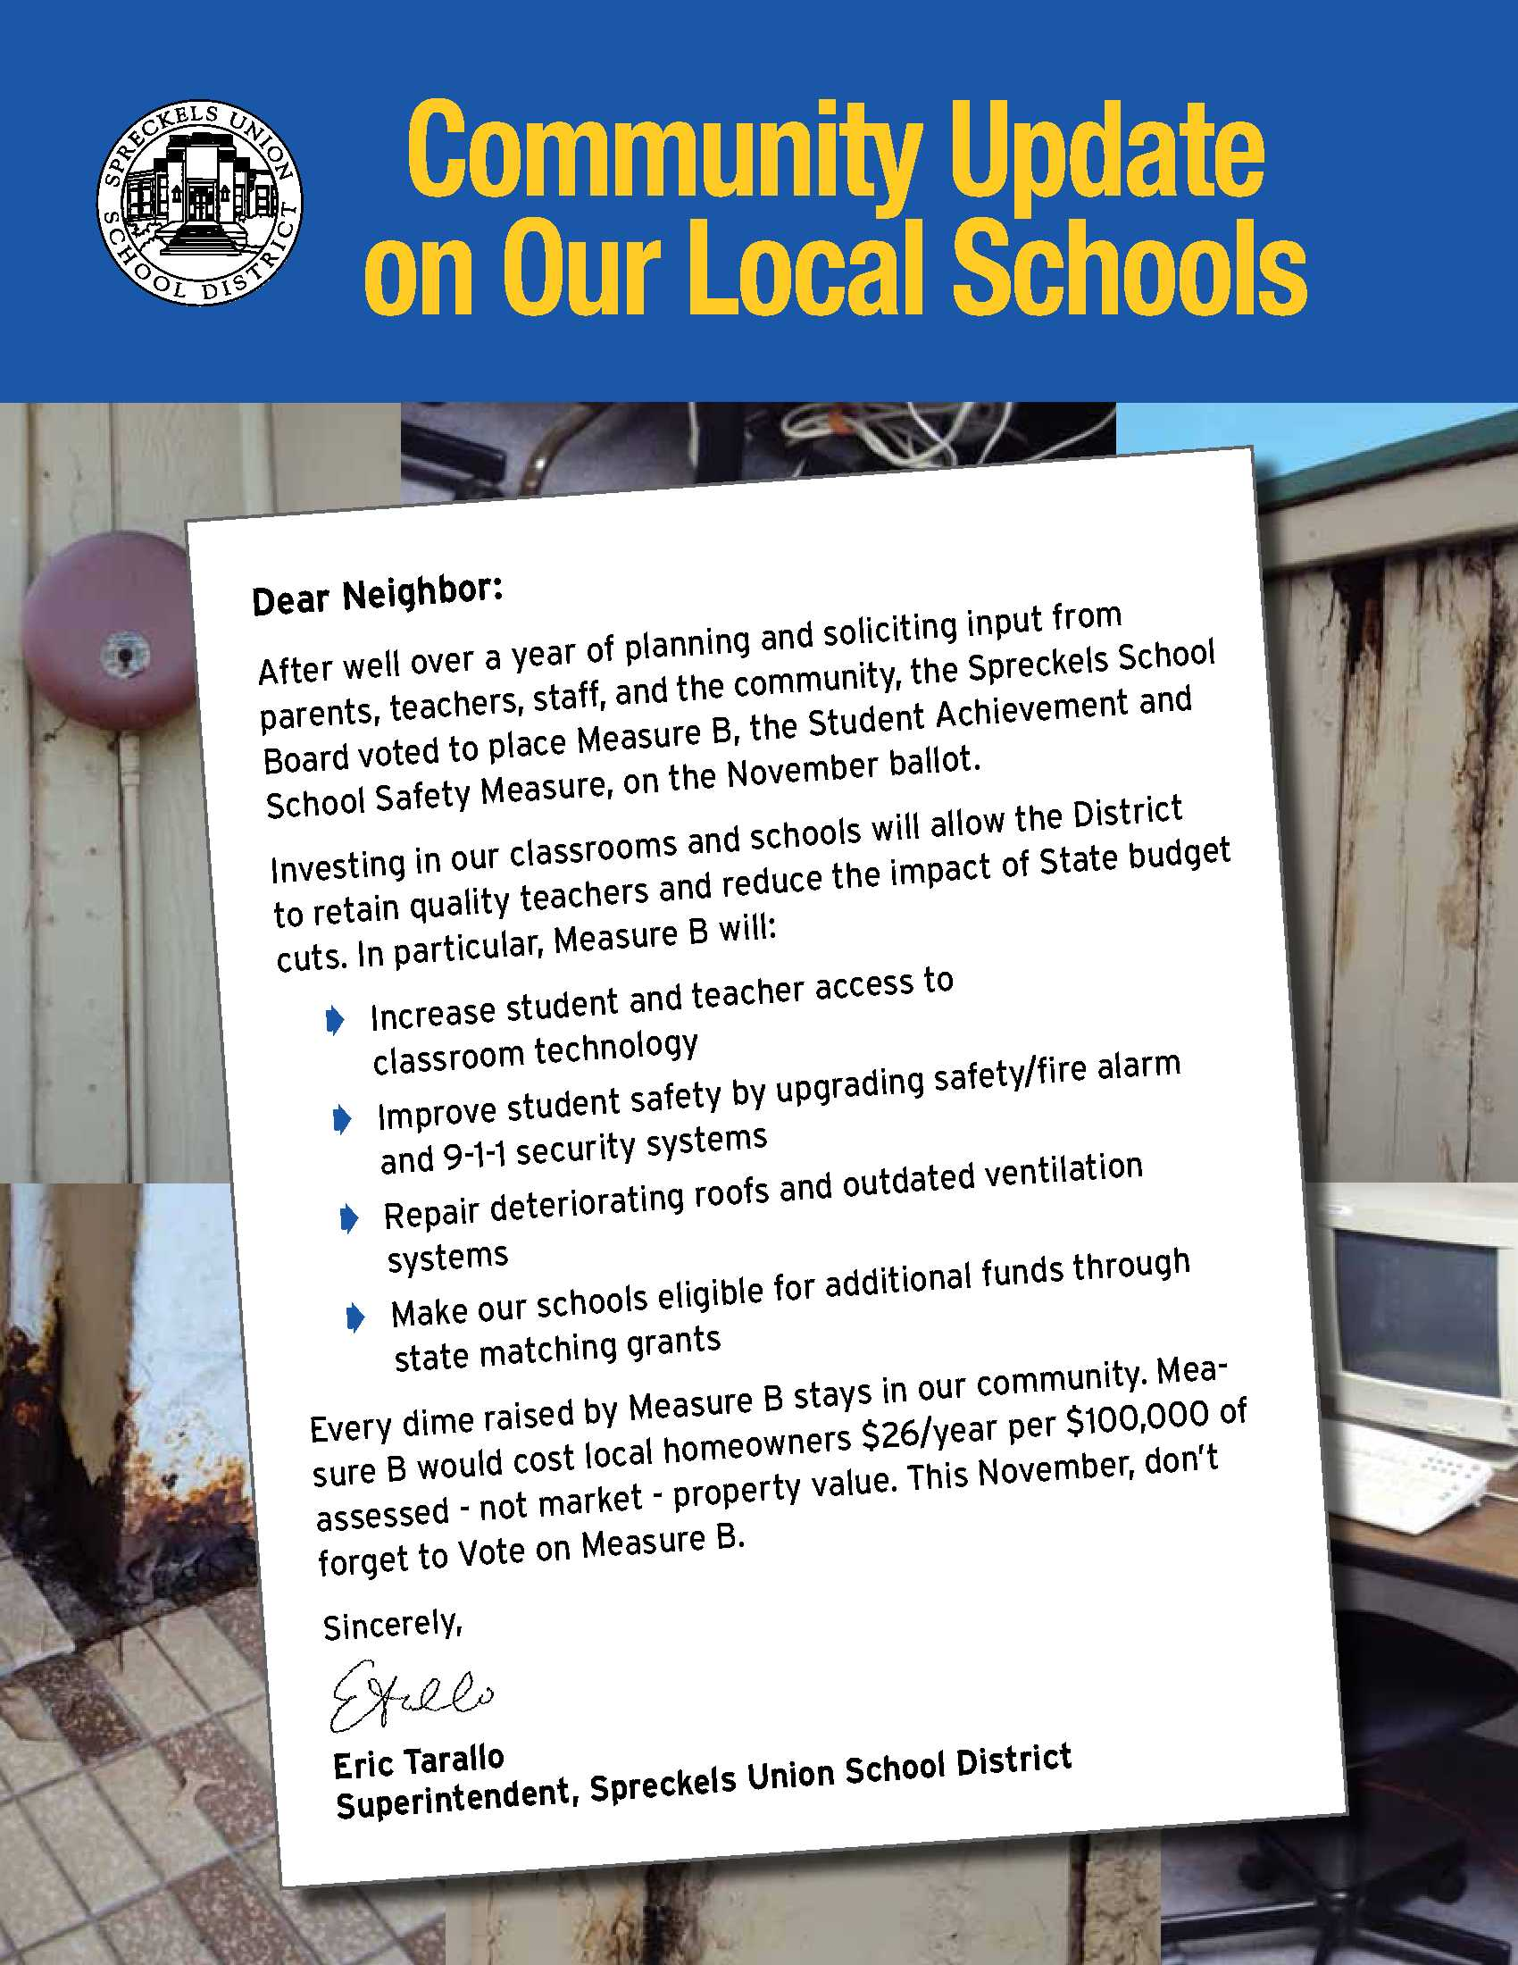

Past Spreckels Union School District Samples

Slide 25

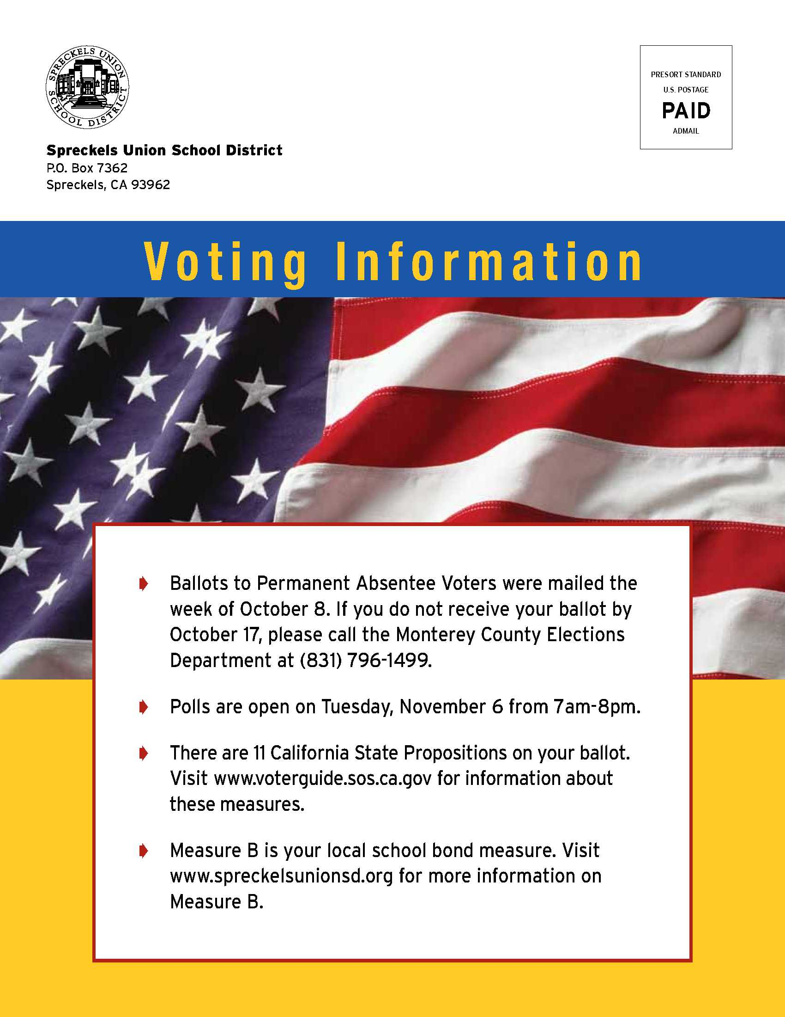
Past Spreckels Union School District Samples

